Slide 1
Webapps – Trends and Business Models
Amit Aggarwal, co-founder and CTO, Via

Slide 2
What are webapps ?
Program on the web
Websites where you read information
Websites where you interact
As simple as a registration form

Slide 3
Via webapp
Travel application - search and booking for flight, buses, rail, hotels and holidays
25 million transactions in 4 years
Served 40 million customers so far
Runs on 50-server farm
More than 10 million sql executions day
A transaction every 2 sec
20,000 ppl every day rely on Via to earn their livelihoods

Slide 4
Large companies are a collection of smaller webapps
Amazon
Yahoo
Facebook
Google
Via

Slide 5
Role of technology
Efficiency/Automation
One view of information
Solving Problems

Slide 6
Role of technology
Efficiency/Automation
One view of information
Solving Problems

Slide 7
World of Solutions and Customers
Booking Travel
E-Commerce
Search
Advertising
Communication

Slide 8
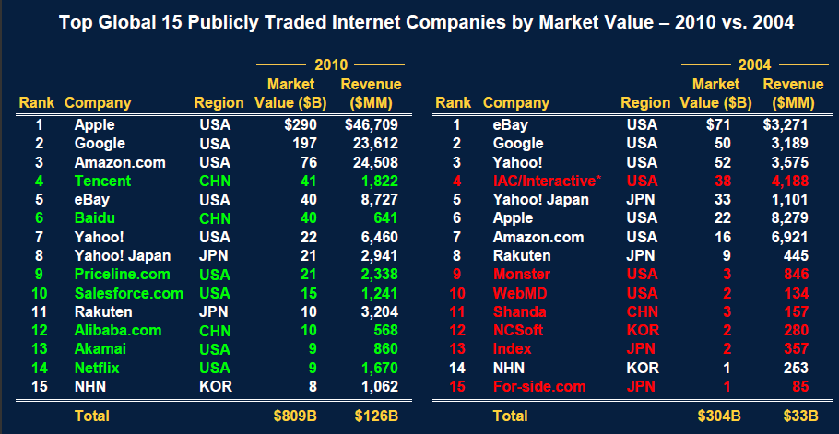
Internet Order
How is it going to change in the next 5 years ?

Slide 9
Emerging models
Group Buying
Social Networking
B2B Commerce
Mobile and 3G
iPad and Tablets

Slide 10
How do you build the next powerful app ?
Identify the problem
Identify customers
Validate the solution
Put together the solution
Get it out !
Listen !

Slide 11
Points to note
MVC is a good framework – Use it right from start
Use what can be used to the maximum – DB is very powerful
Language and platform doesn’t matter – customer’s don’t care about it
Team matters – work with the best people
Best team is the one you have, Best Time is right now

Slide 12
What will be the next killer webapp ?

